Slide 1
Program Control
Instructions are always stored in successive memory locations.
When processed in the CPU, the instructions are fetched from consecutive memory locations and executed.
Each time an instruction is fetched from memory, the program counter is incremented so that it contains the address of the next instruction in sequence.
After the execution of a data transfer or data manipulation instruction, control returns to the fetch cycle with the program counter containing the address of the instruction next in sequence.
On the other hand, a program control type of instruction, when executed, may change the address value in the program counter and cause the flow of control to be altered.
In other words, program control instructions specify conditions for altering the content of the program counter, while data transfer and manipulation instructions specify conditions for data-processing operations.
The change in value of the program counter as a result of the execution of a program control instruction causes a break in the sequence of instruction execution.

Slide 2
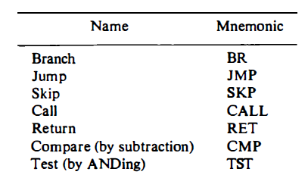
Typical Program Control Instructions
Some typical program control instructions are listed in Table
The branch and jump instructions are used interchangeably to mean the same thing, but sometimes they are used to denote different addressing modes.
The branch is usually a one-address instruction.
Branch and jump instructions may be conditional or unconditional. An unconditional branch instruction causes a branch to the specified address without any conditions.

Slide 3
The conditional branch instruction specifies a condition such as branch if positive or branch if zero.
If the condition is met, the program counter is loaded with the branch address and the next instruction is taken from this address.
If the condition is not met, the program counter is not changed and the next instruction is taken from the next location in sequence.
The skip instruction does not need an address field and is therefore a zero-address instruction.
A conditional skip instruction will skip the next instruction if the condition is met. This is accomplished by incrementing the program counter during the execute phase in addition to its being incremented during the fetch phase.
If the condition is not met, control proceeds with the next instruction in sequence where the programmer inserts an unconditional branch instruction.
The call and return instructions are used in conjunction with subroutines.
The compare and test instructions do not change the program sequence directly.

Slide 4
The compare instruction performs a subtraction between two operands, but the result of the operation is not retained. However, certain status bit conditions are set as a result of the operation.
Similarly, the test instruction performs the logical AND of two operands and updates certain status bits without retaining the result or changing the operands. The status bits of interest are the carry bit, the sign bit, a zero indication, and an overflow condition.
Status Bit Conditions: It is sometimes convenient to supplement the ALU circuit in the CPU with a status register where status bit conditions can be stored for further analysis. Status bits are also called condition-code bits or flag bits.
The four status bits are symbolized by C. S, Z, and V. The bits are set or cleared as a result of an operation performed in the ALU.
1. Bit C (carry) is set to 1 if the end carry C8 is 1. It is cleared to 0 if the carry is 0.
2. Bit S (sign) is set to 1 if the highest-order bit F7, is 1. It is set to 0 if the bit is 0.
3. Bit Z (zero) is set to 1 if the output of the ALU contains all O's. it is cleared to 0 otherwise. In other words, Z = 1 if the output is zero and Z = 0 if the output is not zero.
4. Bit V (overflow) is set to 1 if the exclusive-OR of the last two carries is equal to 1, and cleared to 0 otherwise. This is the condition for an overflow when negative numbers are in 2's complement.

Slide 5
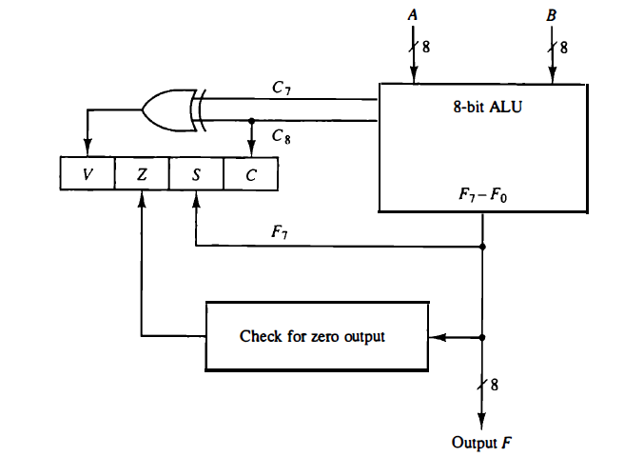
The block diagram of an 8-bit ALU with a 4-bit status register.

